Slide 1

Types:
Heat sinks and cooling fans:
Presentation by:
Dilshad Ali

Slide 2
Heat sinks
Introduction:
Definition: A heatsink is a device that dissipates heat away from components like CPUs, GPUs, and power transistors.

Slide 3

Function:
Importance:
Absorbs and releases heat to maintain an optimal temperature.
Prevents performance degradation and damage to components.

Slide 4
How Heatsinks Work:
Thermal Conduction:
Heatsinks transfer heat from a component through direct contact.
Thermal Dissipation:
Fins and other structures increase surface area, allowing heat to disperse into the air.
Materials:
Often made of high-conductivity metals like copper or aluminum.

Slide 5
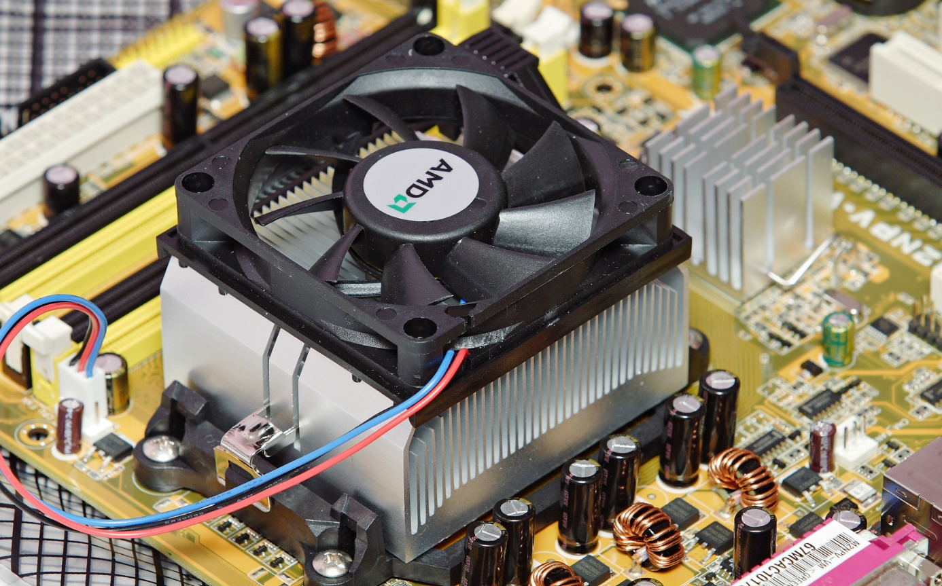
Types of Heatsinks:
Active Heatsinks:
Include an additional cooling fan to assist in heat dissipation.
Examples: CPU coolers, some GPU coolers.
Passive Heatsinks:
No fans; relies solely on surface area and thermal conductivity.
Used in devices where silent operation is essential (e.g., routers).
Hybrid heatsink with both passive and active cooling elements, enhancing heat dissipation for high-performance devices.

Slide 6
What is a Cooling Fan?
Definition: A device that enhances air circulation around a heatsink, increasing cooling efficiency.
Function: Forces cooler air over the heatsink to help carry away heat faster.
Importance: Essential in high-performance systems, where passive cooling alone is insufficient.

Slide 7
Types of Cooling Fans
Case Fans:
Located on the PC case to draw cool air in or expel hot air out.
CPU Fans:
Attached directly to the CPU heatsink for efficient heat dissipation.
GPU Fans:
Integrated into graphics card coolers to manage the high heat output of GPUs.
Exhaust Fans:
Mounted on the back or top of a case to expel warm air from the system.

Slide 8
Comparison of Heatsinks and Cooling Fans:
Heat sinks | Cooling Fans
Passive cooling component, absorbs and disperses heat. | Active cooling component, increases airflow to improve heat sink efficiency.

Slide 9

Thank You
T
Y
h
o
u
a
n
k

